Slide 1


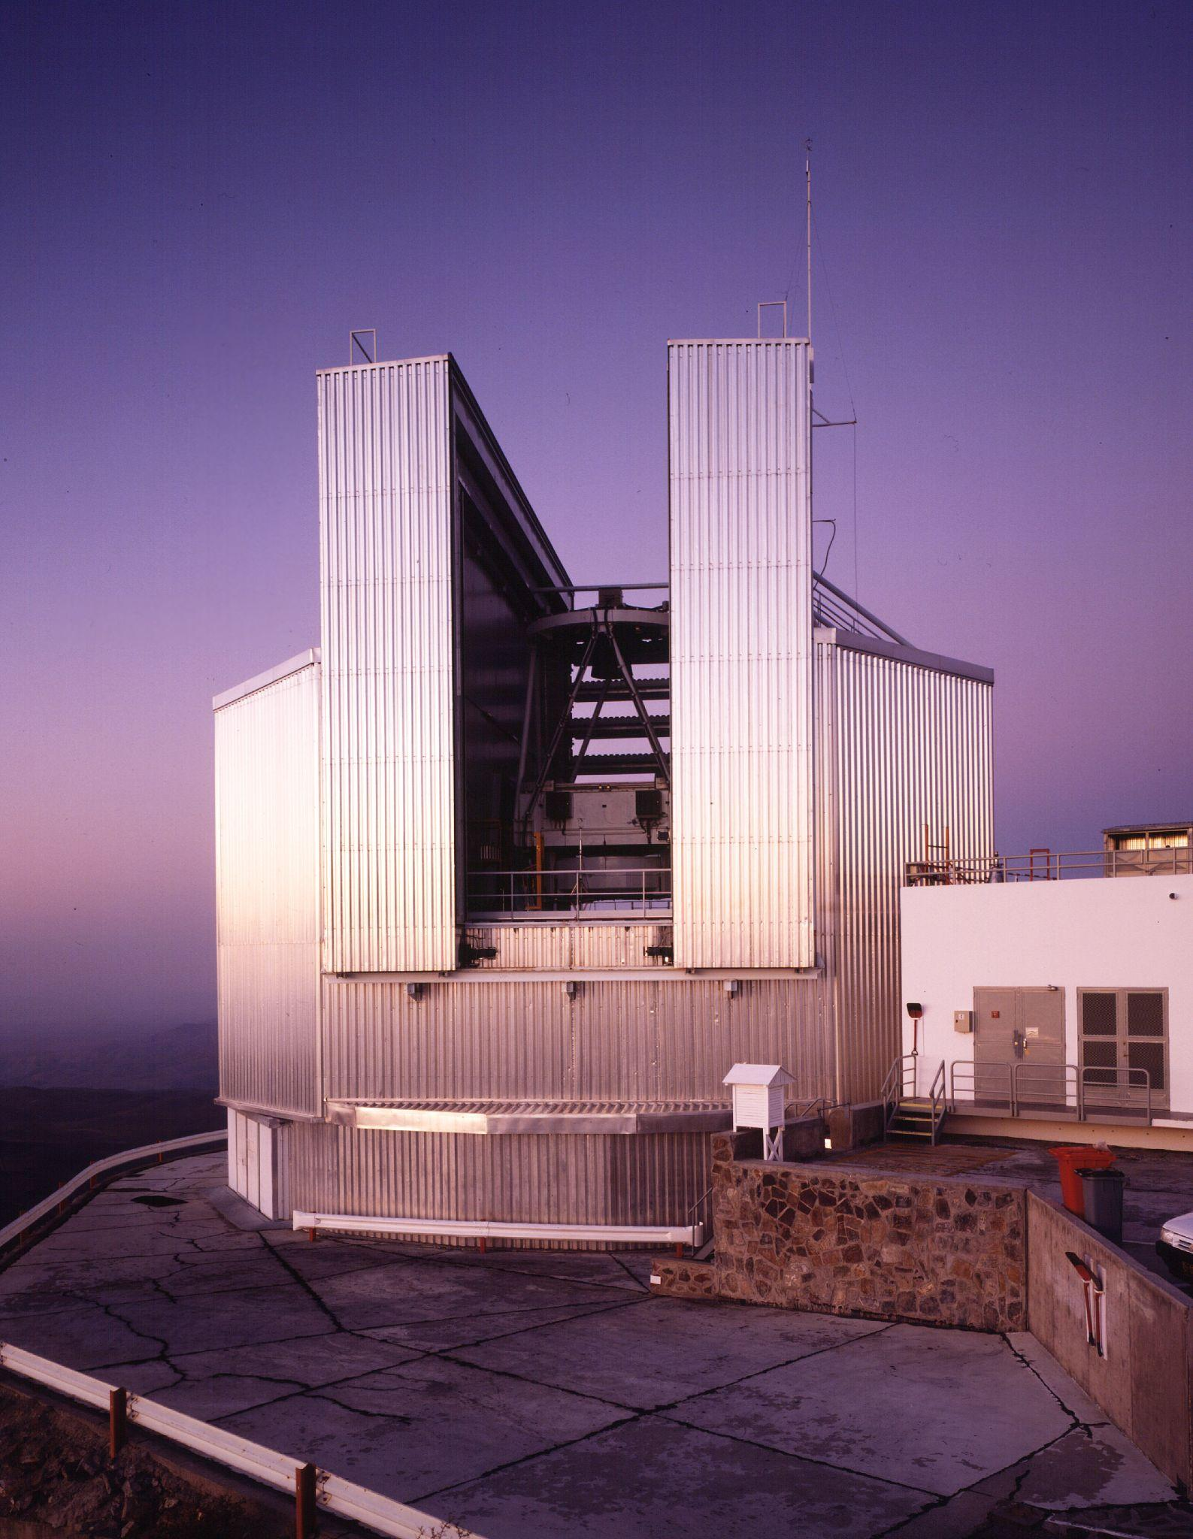



intro to
EXOrs and FUOrs
Teresa Giannini
INAF-OAR
my friend Dario
Notes:
A presentation about our project about the monitoring and characterization of EXOr variables also based on LBT data, called exorcism. A project for which I am co-PI together with my colleague Teresa Giannini.

Slide 2
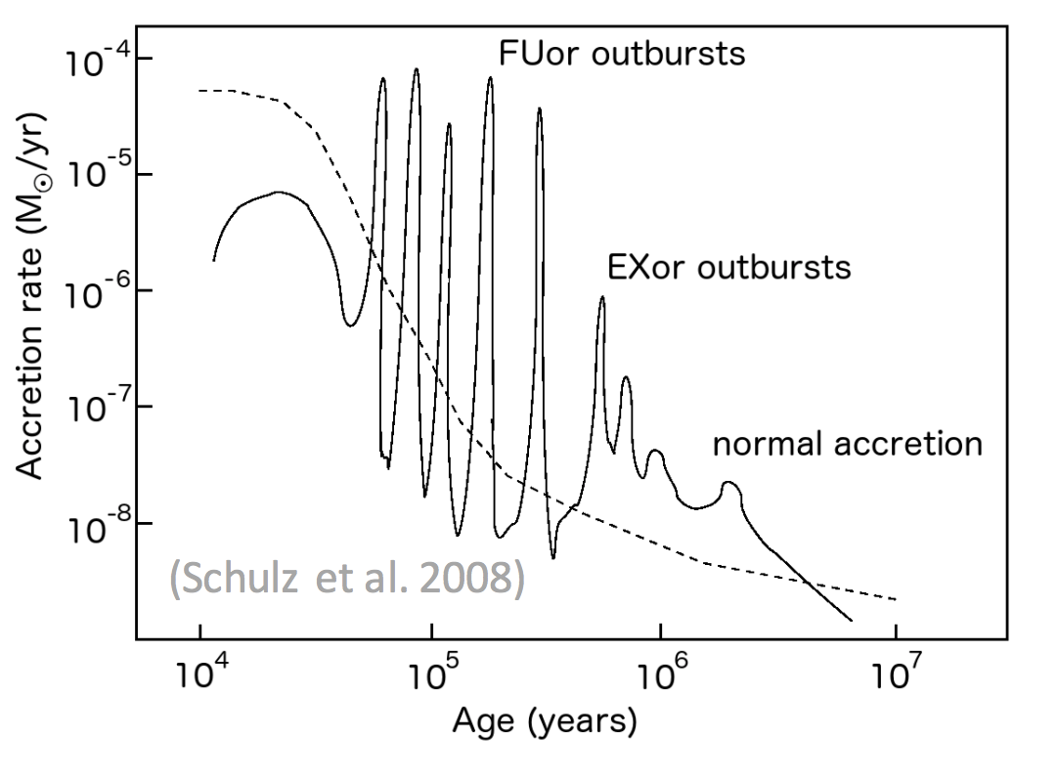
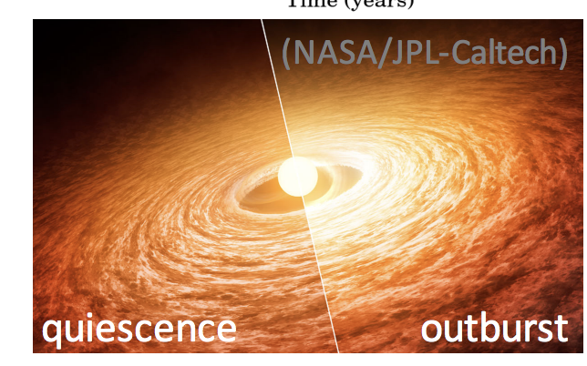
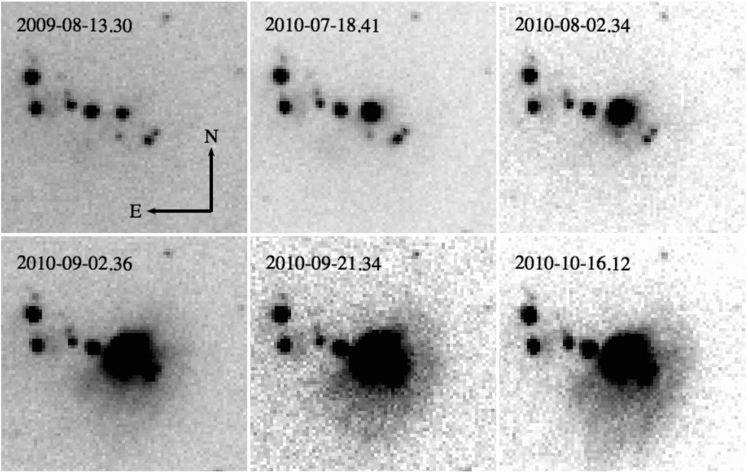
FUors and EXors
‘Classical’ scenario: protostellar accretion and disk evolution are smooth processes over 10⁵-10⁷ yrs
In reality accretion is a variable and inhomogenous phenomenon (in space and time)
Eruptive variables: FUors and EXors, with FUors younger than EXors?
cTTs
V2493 Cyg Miller+ 2011
PALERMO 20-22 GIUGNO 2022 T. Giannini 2
Notes:
A highly interesting aspect in YSOs is the evolution of the accretion rate.
After the intial embedded stage where we have the main acc, the objects become visible at optical wavelengths and continue to accrete at lower rates (TT phase). While varability is a defining featire of TTS, some objects display powerful outburst that are interpreted as phases of enhanced accretion, accretion events...
More pwerful and longer (Fuors) and shorter more moderate (Exors). In this scheme there is an evolutionary sequennce n which… howeber this is not clear.
Also important to investigate if similar outbursts are present at earliest stages...

Slide 3
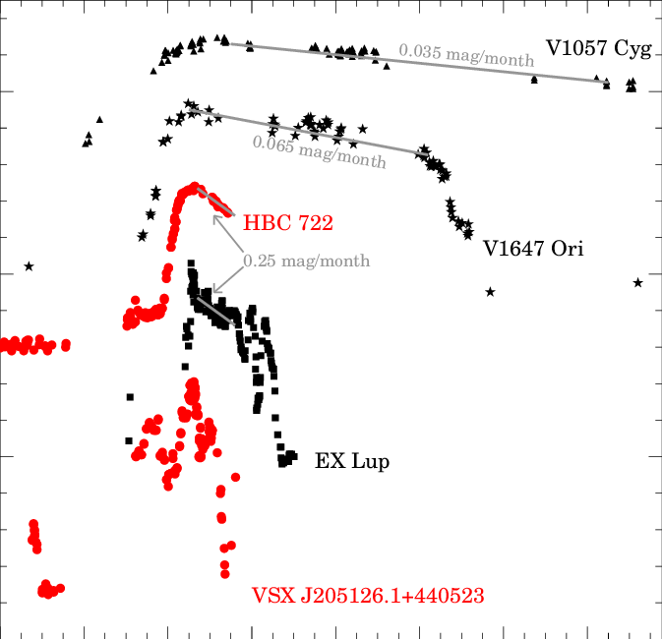
FUors and EXors
Brightening of 2-6 mag in the optical and near-infrared
Bolometric luminosities increase from a few to 100 L☉
Accretion rate may vary by several orders of magnitude
FUor
MNor
V
EXor
Two original classes : FUors and EXors
Intermediate objects (eg V1647 Ori)
New GAIA discoveries….
adapted from Audard+2014
 | ΔV | duration/recurrence | M_{acc} | Spectral features
FUors | 4-6 mag | decades/10³-10⁵ yr | 10⁻⁴- 10⁻⁵ M_{sun}/yr | absorption
EXors | 2-4 mag | months/several years | 10⁻⁶- 10⁻⁷ M_{sun}/yr | emission
Are FUors, MNors, EXors similar phenomena occurring at different ages?
Is the outburst triggering mechanism the same ?
PALERMO 20-22 GIUGNO 2022 T. Giannini 3
Notes:
A highly interesting aspect in YSOs is the evolution of the accretion rate.
After the intial embedded stage where we have the main acc, the objects become visible at optical wavelengths and continue to accrete at lower rates (TT phase). While varability is a defining featire of TTS, some objects display powerful outburst that are interpreted as phases of enhanced accretion, accretion events...
More pwerful and longer (Fuors) and shorter more moderate (Exors). In this scheme there is an evolutionary sequennce n which… howeber this is not clear.
Also important to investigate if similar outbursts are present at earliest stages...

Slide 4
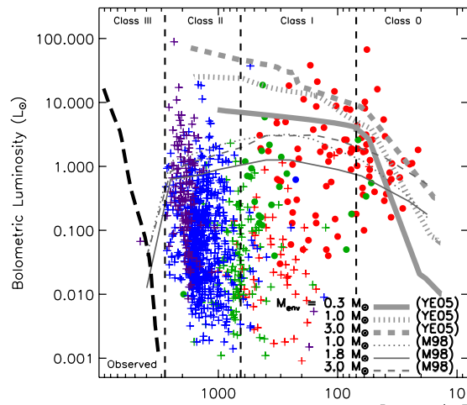
Why EXors/FUors are important?
So far less than 100 known objects ….however...
….Eruptive accretion has been suggested as a possible solution of the ‘luminosity problem’, i.e. YSOs are observed to be on average an order of magnitude less luminous than expected theoretically. Sources spend most of their time in quiescence but are subject to accretion bursts (Evans+2009, Dunham+2013).
Eruptive accretion may contribute to explain the observed luminosity spread of YSOs of the same mass and age (eg. Baraffe+ 2012)
Outbursts can heavily affect disk dispersal and planet formation process, e.g. the increased temperatures can temporarily change the locations of the snowlines (Hubbard 2017)
…..But what is the statiscal impact of young eruptive variables?
PALERMO 20-22 GIUGNO 2022 T. Giannini 4
Notes:
If all YSOs go through eruptive phases, episodic accretion is a possible solutions of the ‘luminosity problem’, i.e. YSOs are observed to be on average an order of magnitude less luminous than expected theoretically (Evans+2008, Dunham+2013)
Eruptive accretion may contribute to exolain the observed luminosity spread of YSOs (Baraffe+ 2012)
Outbursts can heavily affect the planet formation process. For example the increased temperatures can temporarily change the locations of the snowlines (Hubbard 2017)

Slide 5
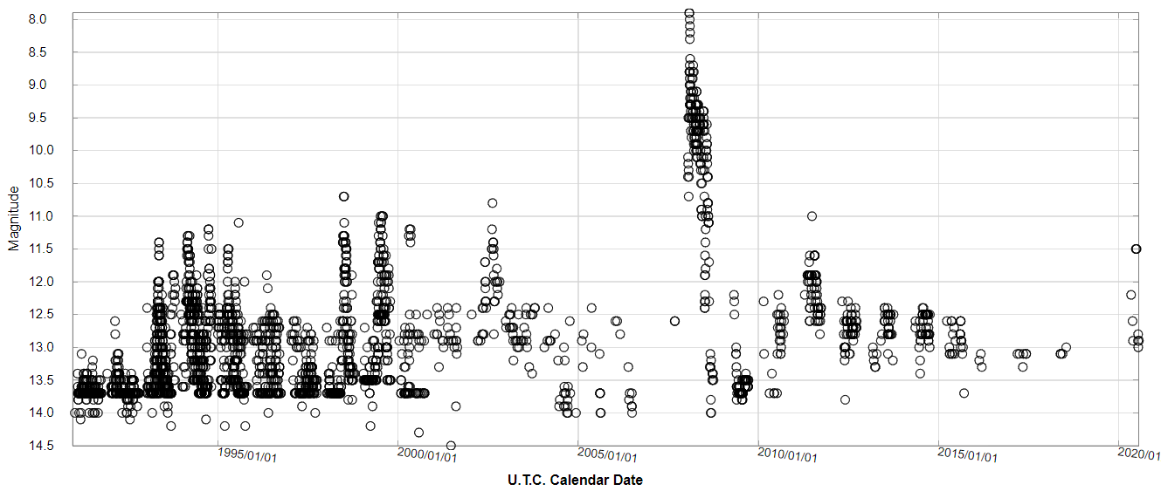
What is needed?
Optical/Near-infrared photometric and spectroscopic monitoring of known EXors and EXor candidates
EX Lup - the prototype
EXors: YSOs with accretion bursts of 2-5 mag
PALERMO 20-22 GIUGNO 2022 T. Giannini 5

Slide 6
EXor monitoring
Build multi-band, multi-year light-curves to:
find genuine EXor candidates (eg EXor vs UXor)
multi-year: outbursts, periodicity
multi-band: evolution of the photometric properties (SEDs, colors)
EXor
UXor/dipper
Flux
Flux
Time
Time
Optical/Near-infrared spectroscopic follow-up
build library of optical/NIR quiescence spectra of EXors and candidates to define the zeroes of the physical and accretion parameters (Macc)
comparison of quiescence/outburst accretion parameters
PALERMO 20-22 GIUGNO 2022 T. Giannini 6

Slide 7
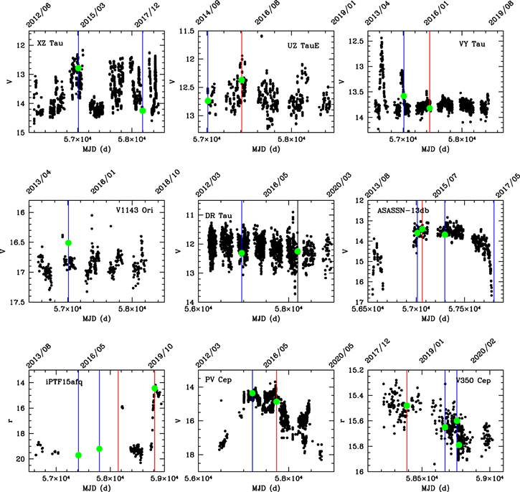
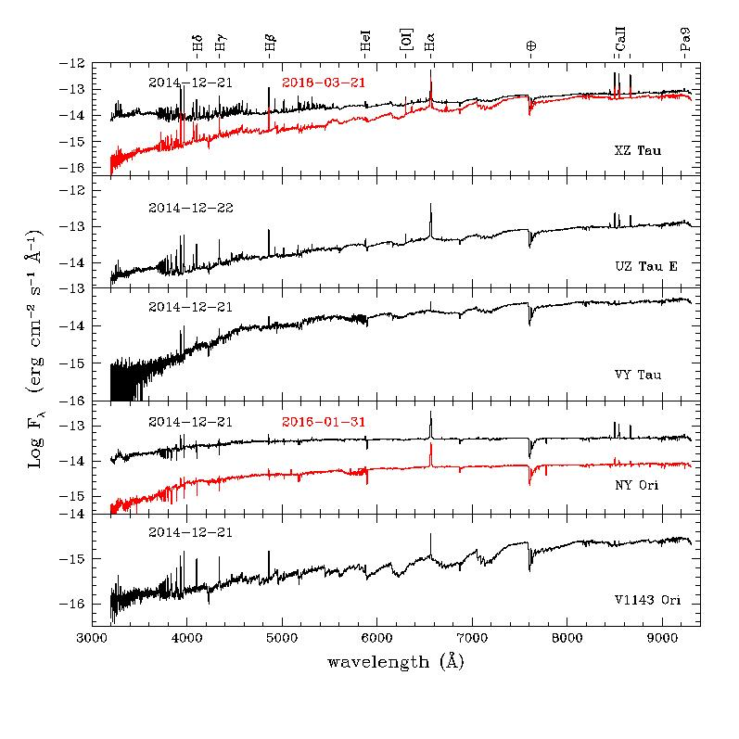
Classical EXors
Giannini+ 2022
PALERMO 20-22 GIUGNO 2022 T. Giannini 7

Slide 8
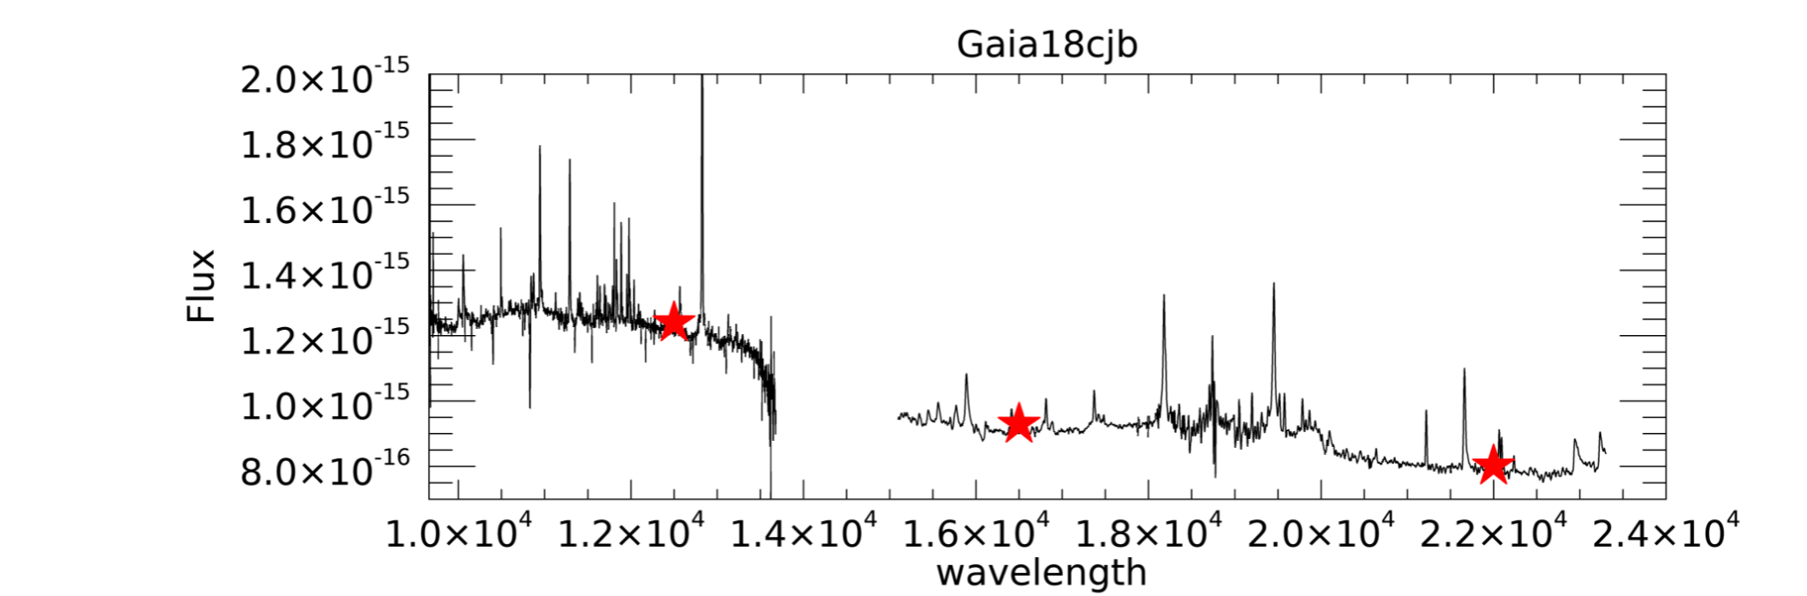
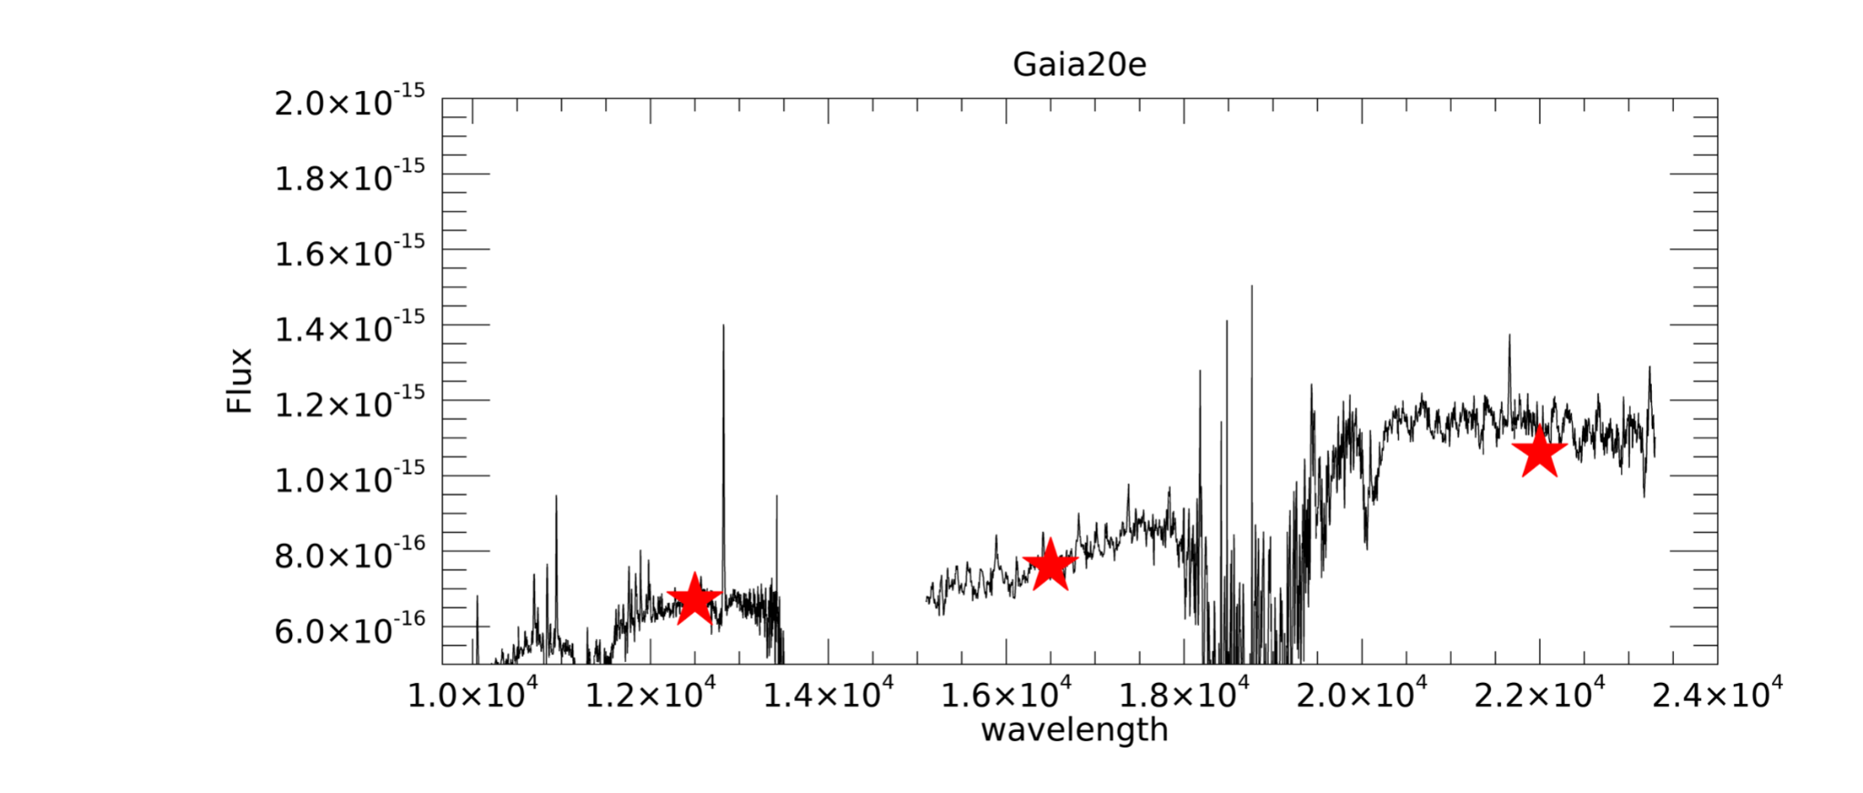
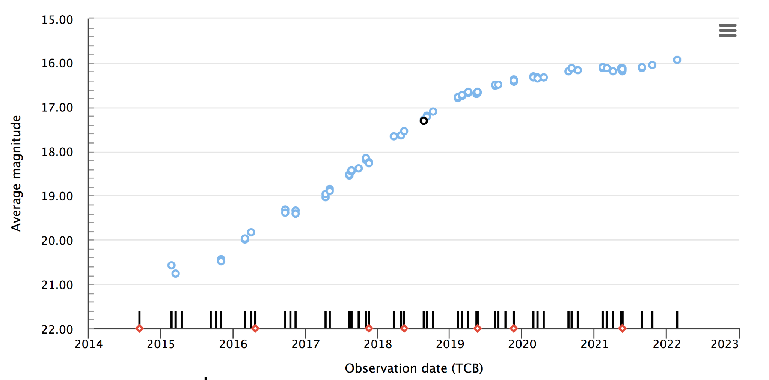
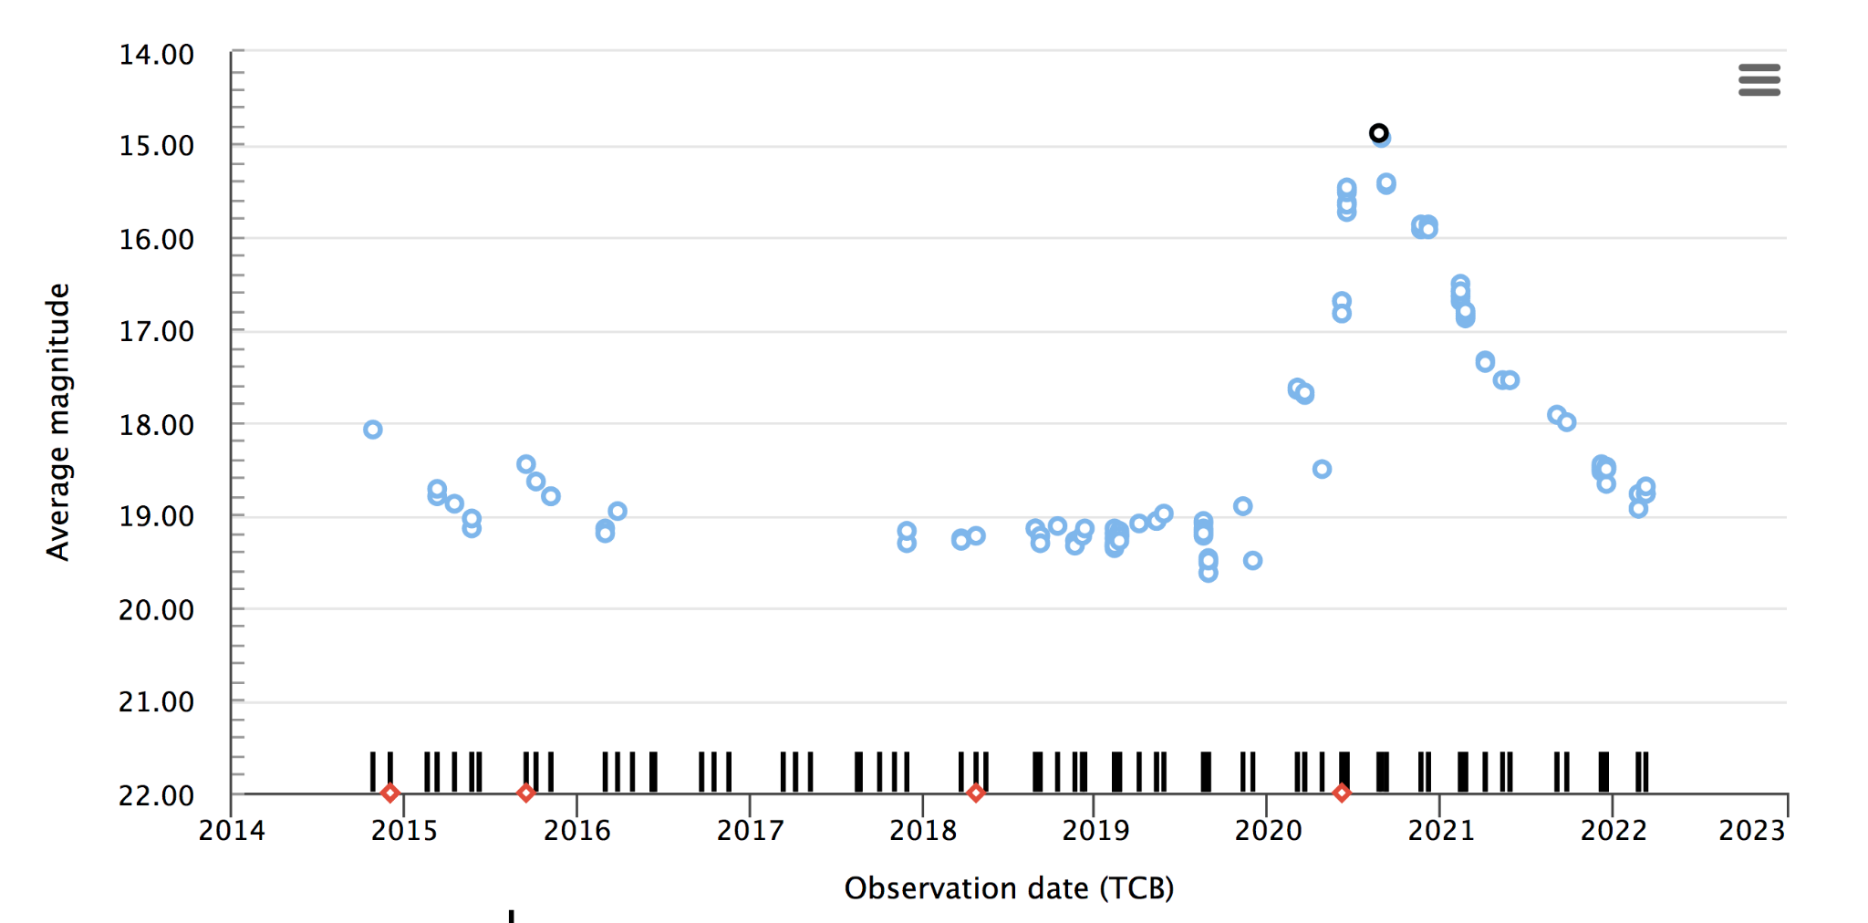
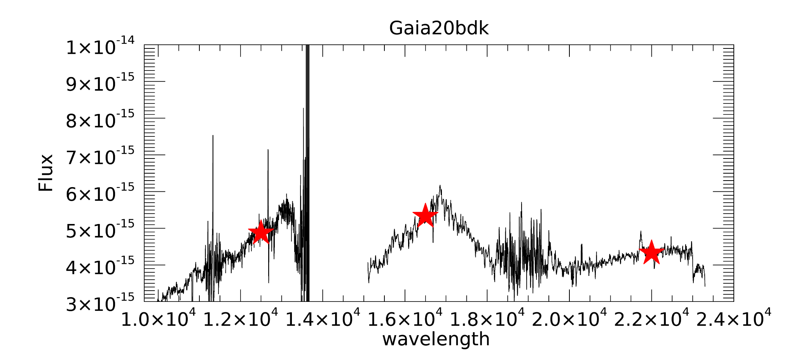
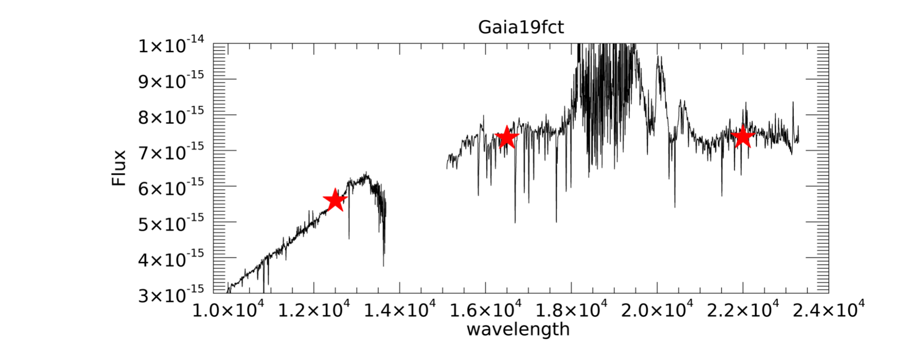
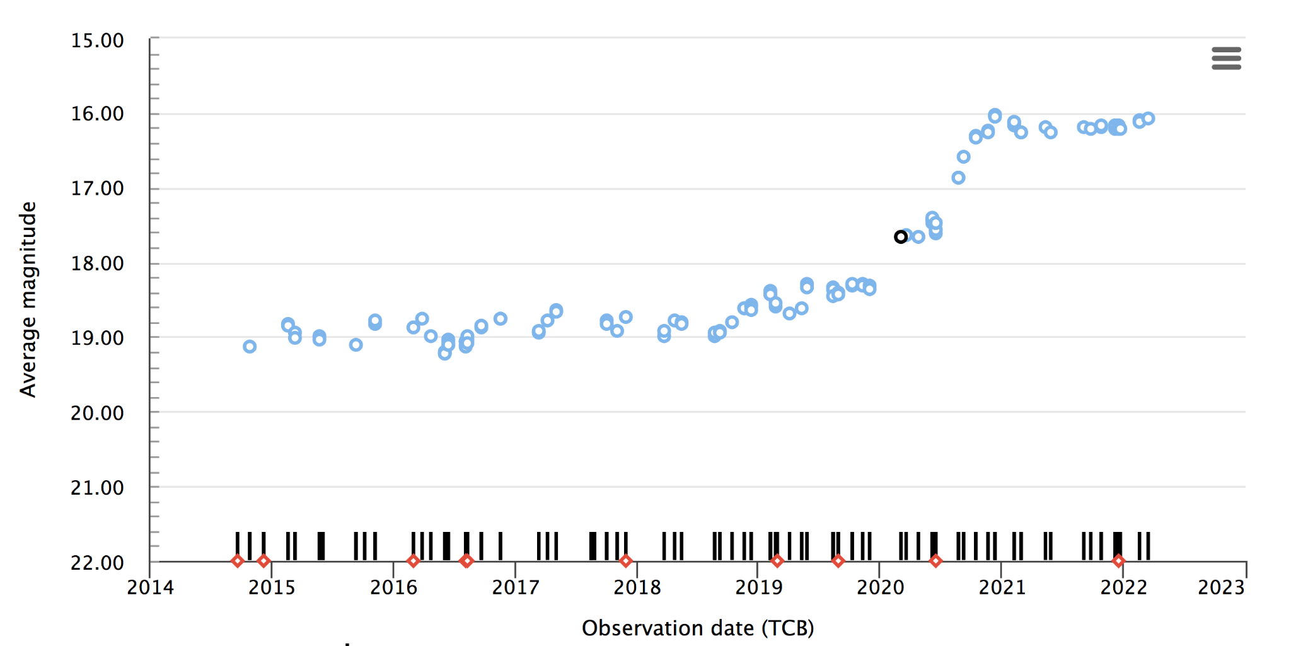
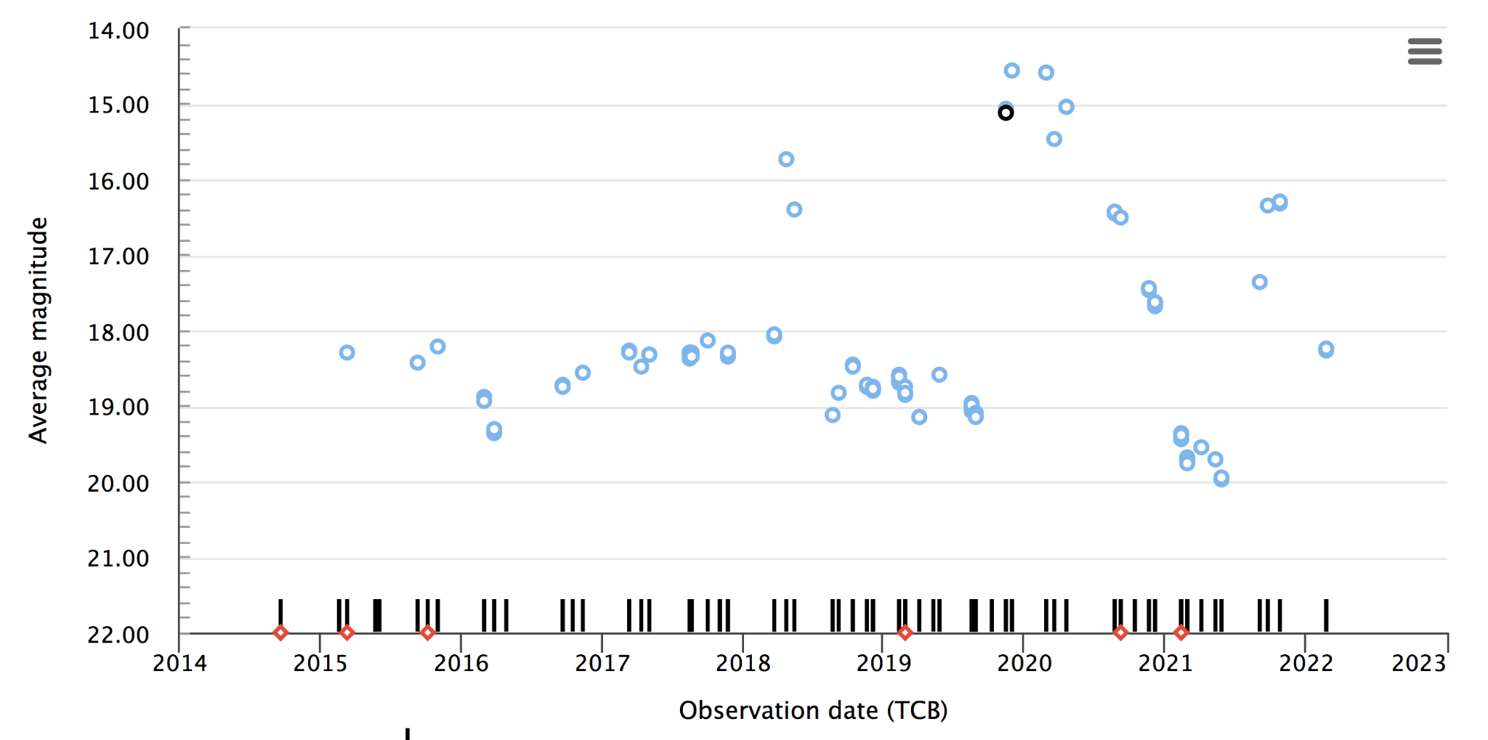
LBT spectra of Gaia alerts
lightcurve rising, lines in emission
a ‘classical’ EXor
a ‘classical’ FUor?
what is this?
Giannini+ in prep
PALERMO 20-22 GIUGNO 2022 T. Giannini 8

Slide 9
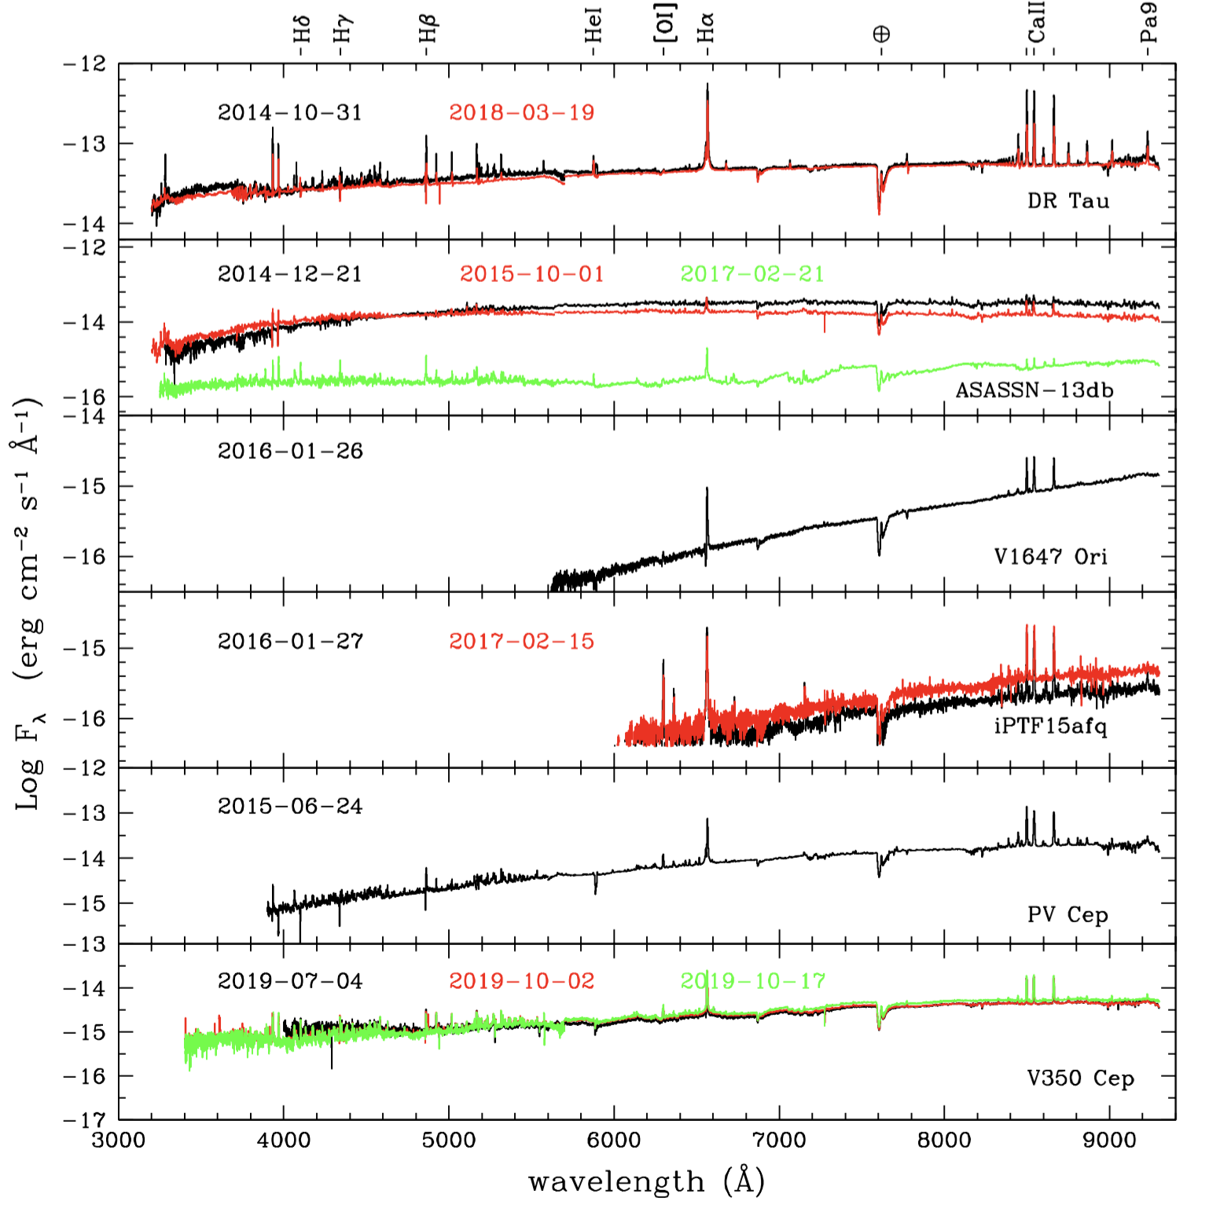
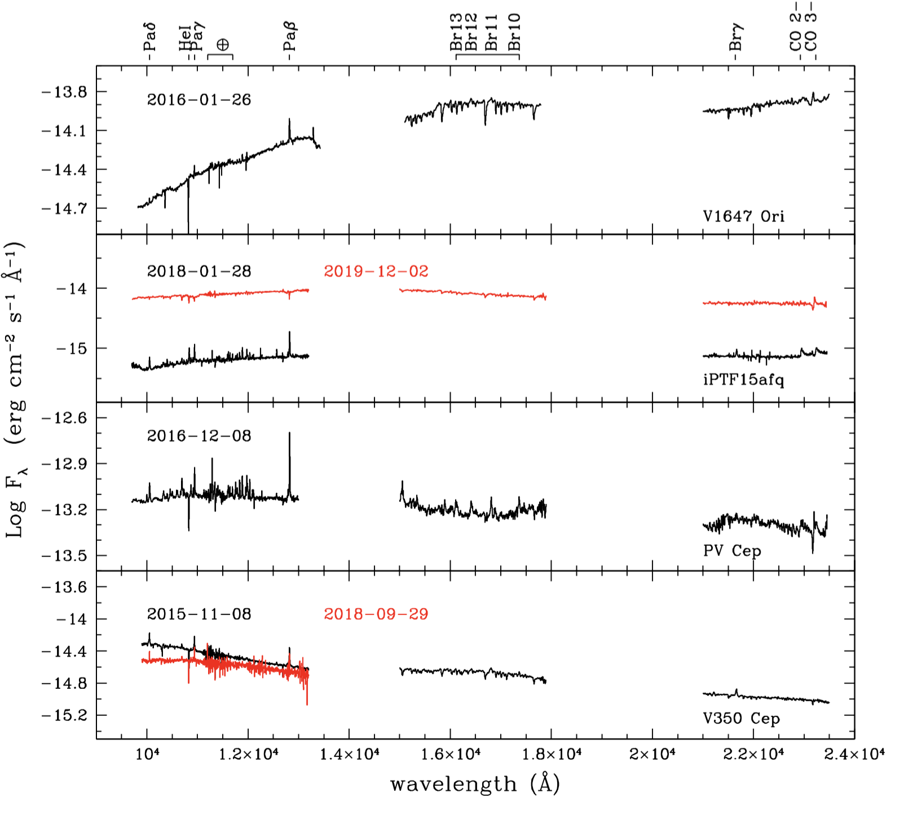
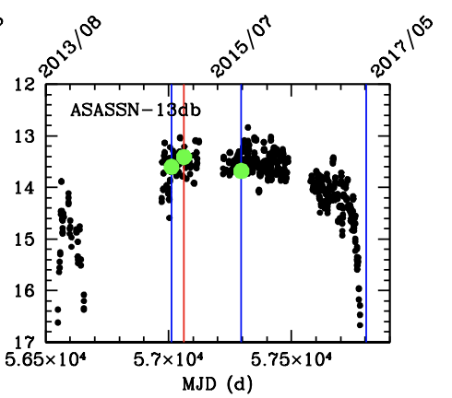
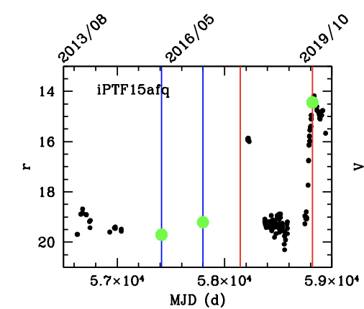
The EXORCISM program
EXORCISM: LBT low-resolution spectroscopy with MODS and LUCI
14 objects monitored with MODS and LUCI (Giannini+2022)
4 outbursts found : V1118 Ori, NY Ori, ASASSN-13db and iPTF15afq
ASASSN-13db
𝚫V=4 mag
-14
-16
-14
iPTF15afq
𝚫V=6 mag
-15
V
MODS
LUCI
100% HI lines in emission
90% forbidden lines ([OI]630 nm)
Several with Balmer jump
PALERMO 20-22 GIUGNO 2022 T. Giannini 9
Notes:
If all YSOs go through eruptive phases, episodic accretion is a possible solutions of the ‘luminosity problem’, i.e. YSOs are observed to be on average an order of magnitude less luminous than expected theoretically (Evans+2008, Dunham+2013)
Eruptive accretion may contribute to exolain the observed luminosity spread of YSOs (Baraffe+ 2012)
Outbursts can heavily affect the planet formation process. For example the increased temperatures can temporarily change the locations of the snowlines (Hubbard 2017)

Slide 10
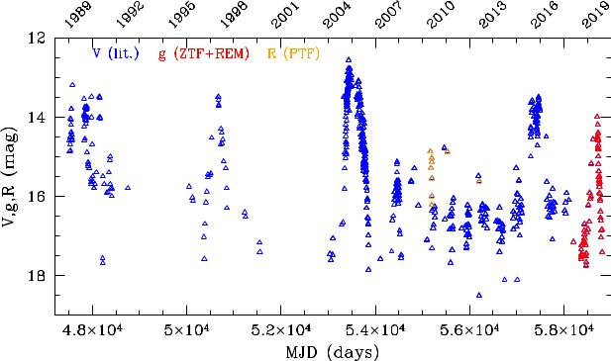
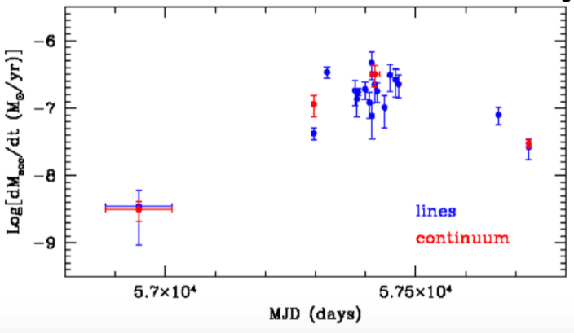
The case of V1118 Ori
7 outbursts in 30 yrs , last in 2019
outbursts of the same source may differ from each other...
Macc(quiesc) ~ 3 10⁻⁹ Msun/yr
Macc(2005 outburst -𝚫V=6) ~ 10⁻⁶Msun/yr
Macc(2015 outburst-𝚫V=5) ~ 10⁻⁷Msun/yr
Giannini+. 2016, 2017, 2020
PALERMO 20-22 GIUGNO 2022 T. Giannini 10
Notes:
If all YSOs go through eruptive phases, episodic accretion is a possible solutions of the ‘luminosity problem’, i.e. YSOs are observed to be on average an order of magnitude less luminous than expected theoretically (Evans+2008, Dunham+2013)
Eruptive accretion may contribute to exolain the observed luminosity spread of YSOs (Baraffe+ 2012)
Outbursts can heavily affect the planet formation process. For example the increased temperatures can temporarily change the locations of the snowlines (Hubbard 2017)

Slide 11

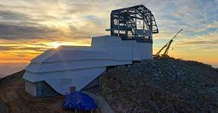
Vera Rubin-LSST
increase the number of EXor/FUor candidates
monitor known objects for a decade
discover new FUors and observe the rising phase
investigate the EXor/FUor phenomenon in phases earlier than PMS
define the statistical impact of eruptive vs non-eruptive PMS
discriminate between intrinsic and extrinsic variables
obtain clues on the mechanism(s) triggering the outburst
solve the luminosity problem
EXORS @ Vera Rubin Telescope
1. Mag variation alert (e.g. Δmag > 1)
2. Location in a star-forming region
Photometry
3. SED typical of YSO (rising with λ)
candidate
eruptive variables
4. Lightcurve (and colours)
EXors and FUors are scientific goals of the Transient and Variable Stars (TVS) Science Collaboration
PALERMO 20-22 GIUGNO 2022 T. Giannini 11
Notes:
If all YSOs go through eruptive phases, episodic accretion is a possible solutions of the ‘luminosity problem’, i.e. YSOs are observed to be on average an order of magnitude less luminous than expected theoretically (Evans+2008, Dunham+2013)
Eruptive accretion may contribute to exolain the observed luminosity spread of YSOs (Baraffe+ 2012)
Outbursts can heavily affect the planet formation process. For example the increased temperatures can temporarily change the locations of the snowlines (Hubbard 2017)

